Slide 1
TRADITIONAL METHODS VS LATEST METHODS
By: Sahithya Shre H

Slide 2
OBJECTIVE
To complete the project in a structured, sequential way, where each phase (like design, development, testing) is fully finished before moving to the next.
To quickly create a working version (prototype) of the system to better understand and refine requirements based on user feedback.
Each increment adds a functional piece, allowing faster delivery

Slide 3
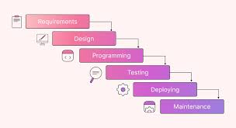
WATERFALL MODEL
The Waterfall model is achieved by completing each project phase sequentially
Gathering full requirements first, then designing, developing, testing, and deploying without going back.

Slide 4
DRAWBACK
Late discovery of problems during testing.
Customer feedback comes too late, after full development.
Expensive fixes if changes are needed in later stages.

Slide 5
ADVANTAGES
Simple and easy to manage due to clear steps.
Structured approach ensures thorough testing after development.
Best suited for fixed-scope projects where requirements don't change.

Slide 6
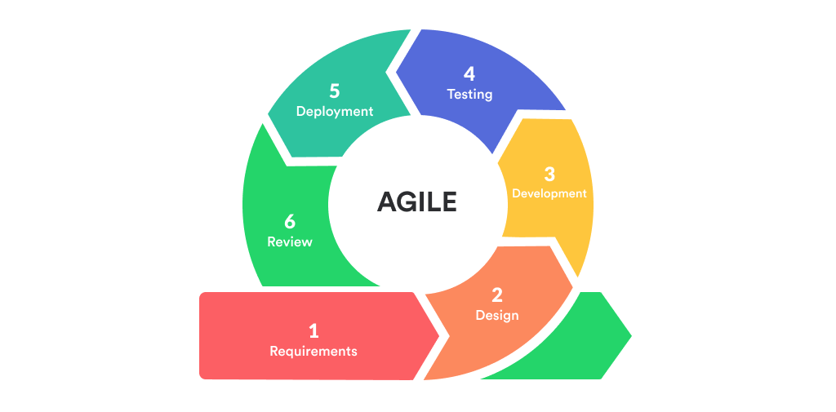
AGILE
Agile is a flexible and adaptive project management approach that breaks work into small, manageable pieces.
It focuses on continuous collaboration with the customer, and welcomes changes even late in the project to deliver value faster and more efficiently.

Slide 7
OVERCOMING DRAWBACKS
TRADITIONAL METHOD | AGILE METHOD
Inflexible to changes | Agile welcomes changes anytime, even late.
Slow delivery | Agile delivers working parts quickly (every sprint).
Customer feedback comes too late | Agile involves the customer throughout the project.
Poor adaptability to evolving needs | Agile adapts quickly to new needs or priorities.

Slide 8
PROCESS
.
.
Plan: Define goals, prioritize tasks, and create a backlog.
Develop: Work on selected tasks in short, time-boxed sprints (1-4 weeks).
Test & Review: Continuously test and review the work, gather customer feedback.

Slide 9
ADVANTAGES
Delivers working software quickly in iterations, allowing for earlier product release.
Frequent updates and reviews keep everyone aligned on progress.
Easily adapts to changing requirements even late in the project.

Slide 10
THANK YOU

